Slide 1
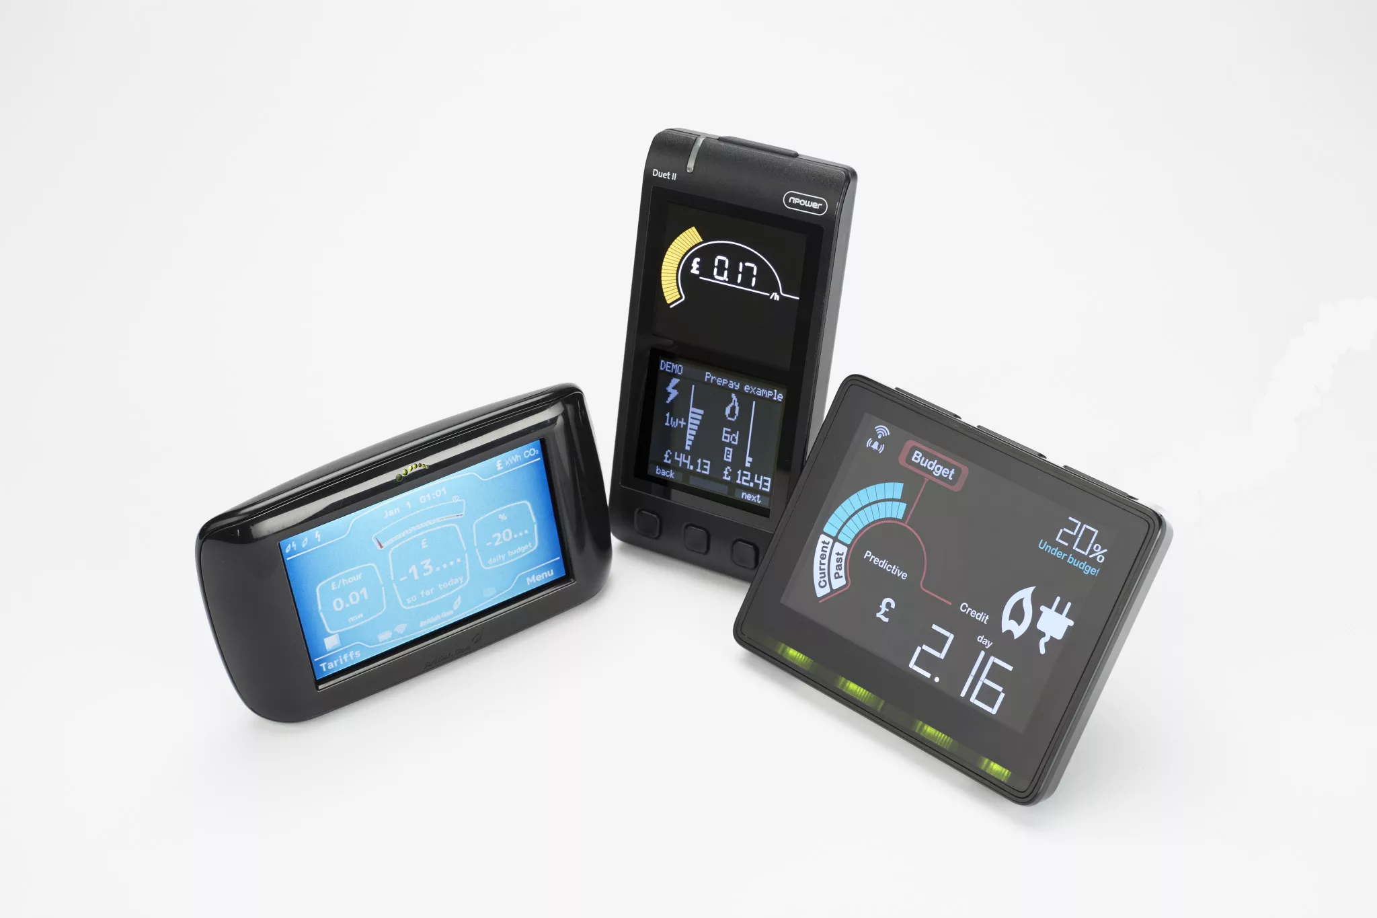
Smart Metering
Single-channel
Or multi-channel
RUBBISH

Slide 2
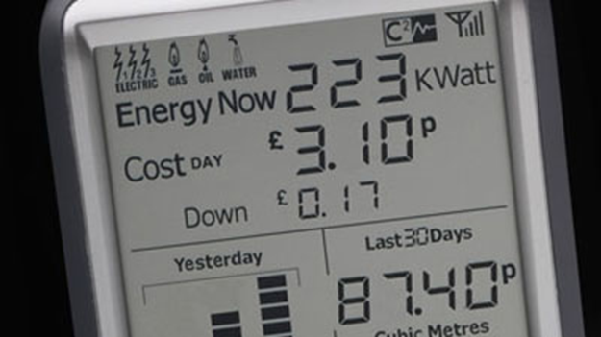
Single Channel
Only gives very limited info
Can you see the washing machine in 223kW ?
No
So how can you tell what's costing you the money!
Yes the kettle blips the display up but only for a few seconds

Slide 3
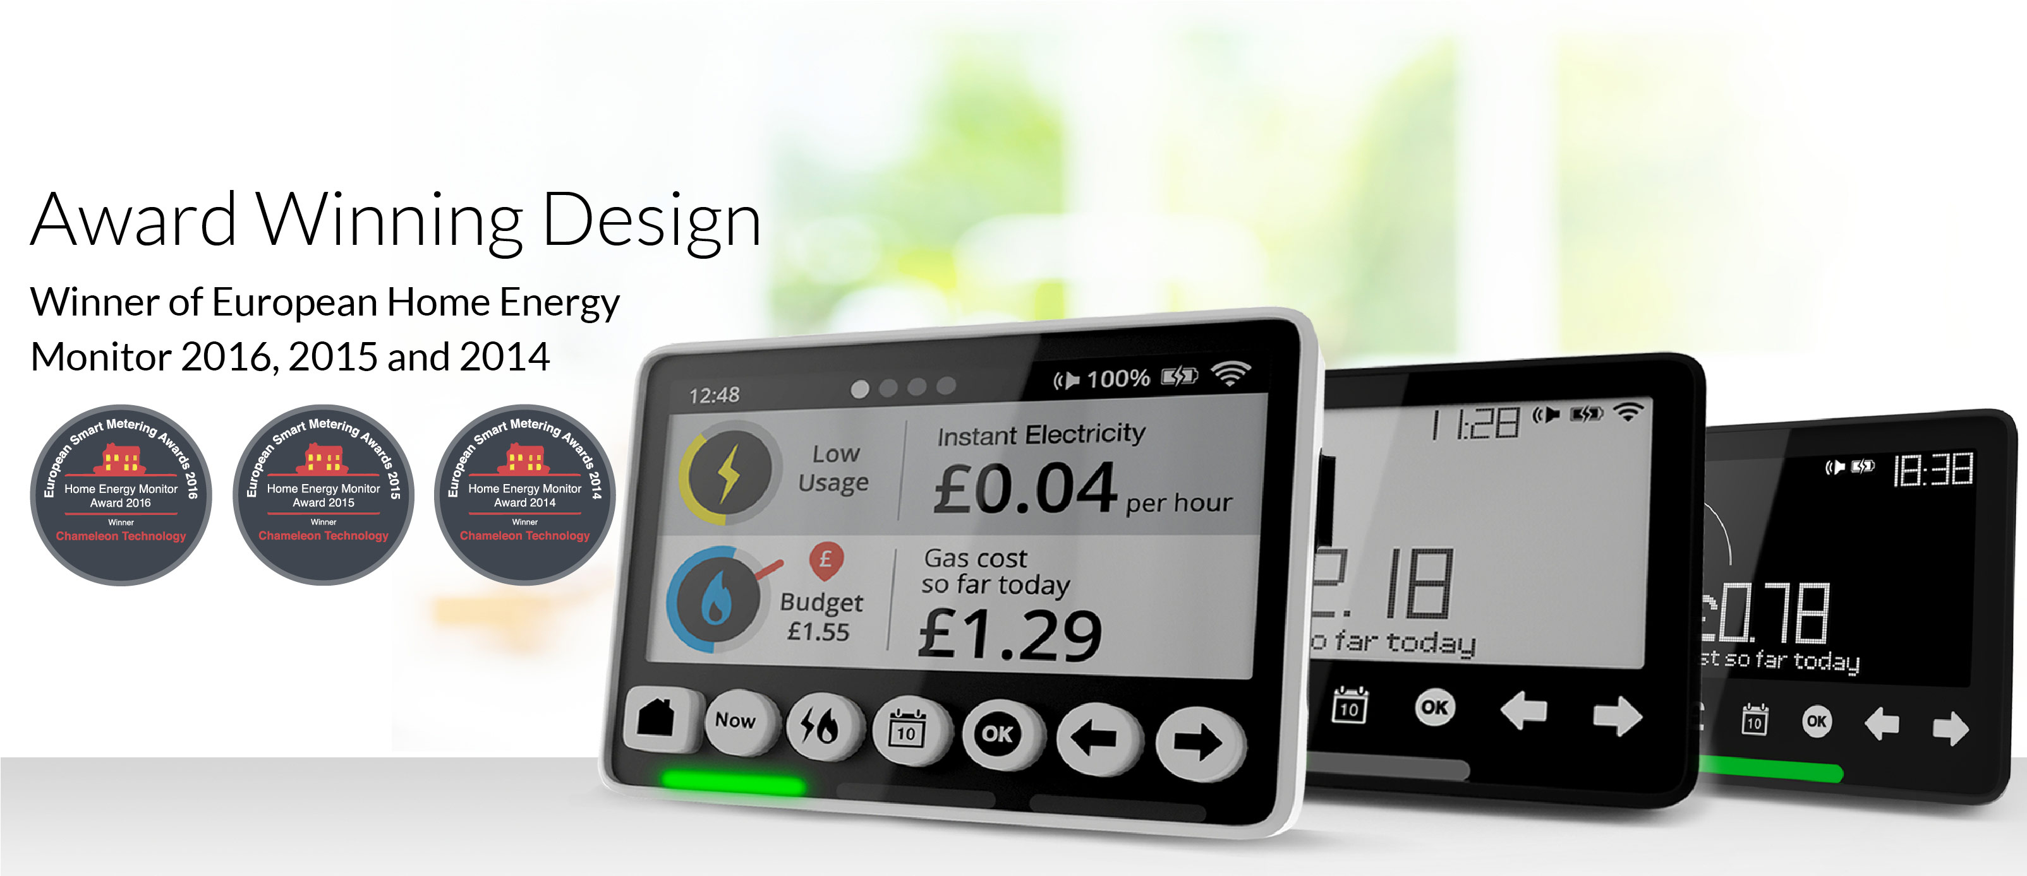
Not the way to go
How can users guess where the power’s going

Slide 4

Smart Metering
multi-channel
THIS IS WHY

Slide 5
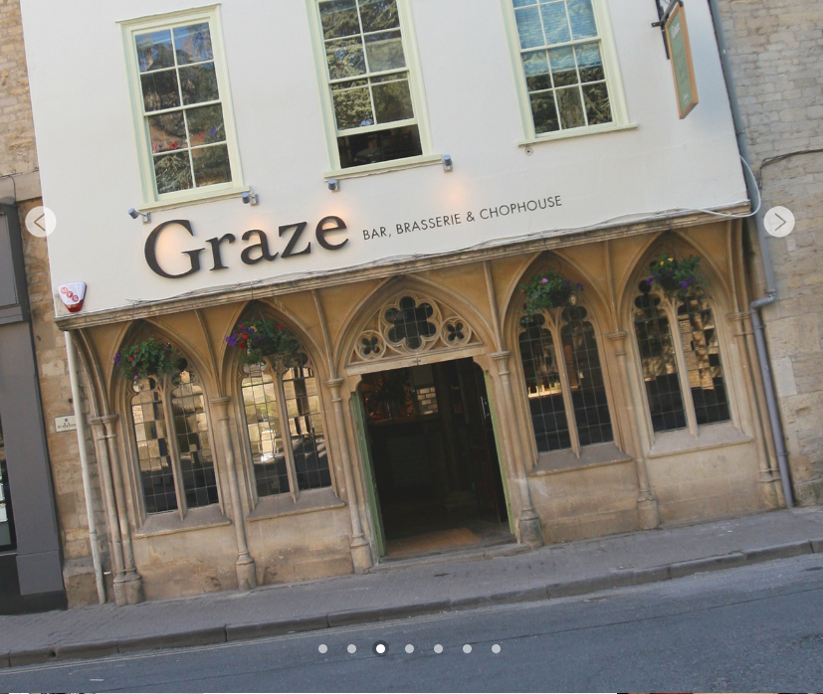
Graze Wine Bar Cirencester
Installed multi-channel Eddie 2 years ago.
3Phase dist. in Cellar 1 in Kitchen (24cct)
Data sent to internet over cable & owners own broadband
Just by identifying the large users of power the manager (Jay) was able to cut consumption by 26.5%
26.5% saving with NO OUTLAY

Slide 6
Example
Example of savings possible by using Dis-aggregated
data
The user needs to see exactly where the energy is going

Slide 7
Who, What, Where, Why, When?
In March the managers at Graze Wine Bar asked if we could analyse their consumption
They were concerned at their high energy bills
They were right to be worried
  Their electricity alone was
    11,127 kWh = £1,780.32/month
  THAT’S £21,363 ANNUALLY !!

Slide 8
The What, Where, Why, When?
Using the output of Eddie
We could immediately see where power was wasted
The obvious ones were
  Cellar chiller & lights
  Coffee machine on all night
  ‘Pass’ (heated shelf) left on all day
  Bar overhead lights
Later we looked closer, but these will do for starters

Slide 9
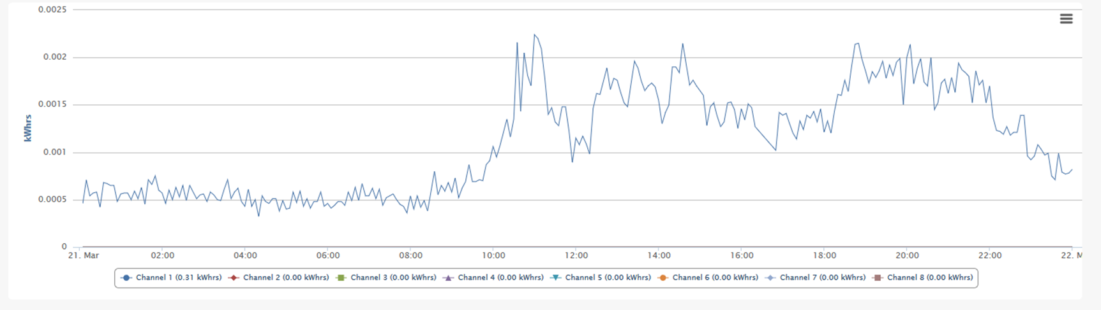
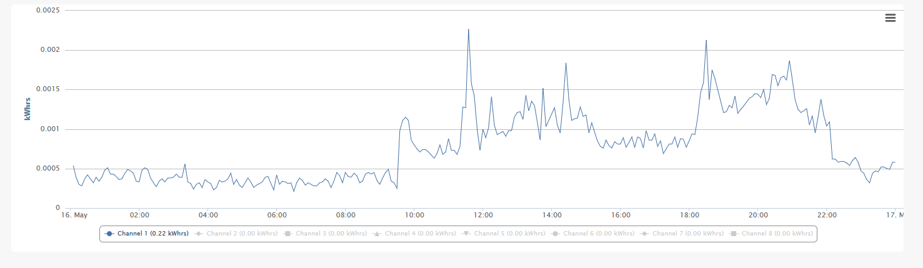
Electricity – March compared to May
Even better reduction in day
Good reduction at night

Slide 10
Early big changes
50% of the whole bar’s consumption was going into the cellar
Not a surprise when investigated
  The Chillers & Ice machine were pumping hot air into the cellar
  Which was then being cooled again by the cellar chiller (set to 12’C)
So EASY ANSWER
  Separate the heat generators from Chilled area
  Moved the Ice machine & Python to one end
  Moved the cellar chiller to the other end
  Install a curtain to separate the two halves
Put lights on automatic
SAVING – OVER 50kWh / day

Slide 11
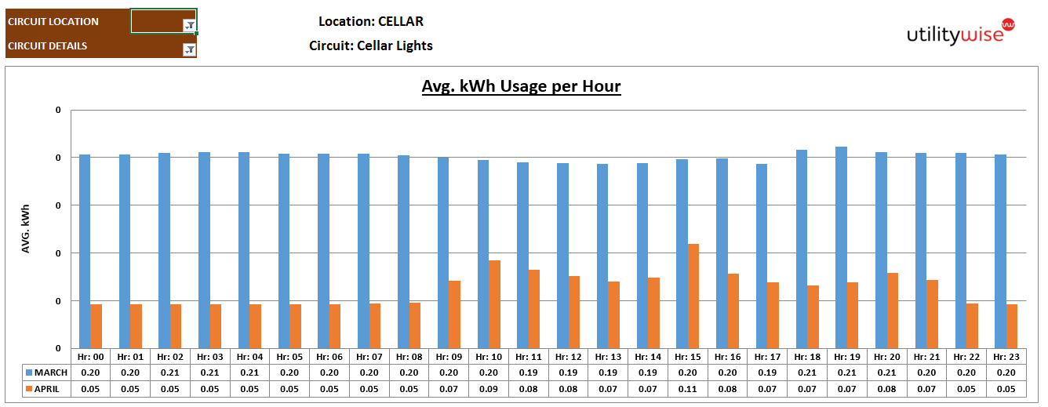
Cellar Lights
An example small but important
Blue is March
Orange is April

Slide 12
Smallish Changes
A little bit of knowledge and effort can produce dramatic results.
Plastic curtain separates the heat generators from the beer cooler.

Slide 13
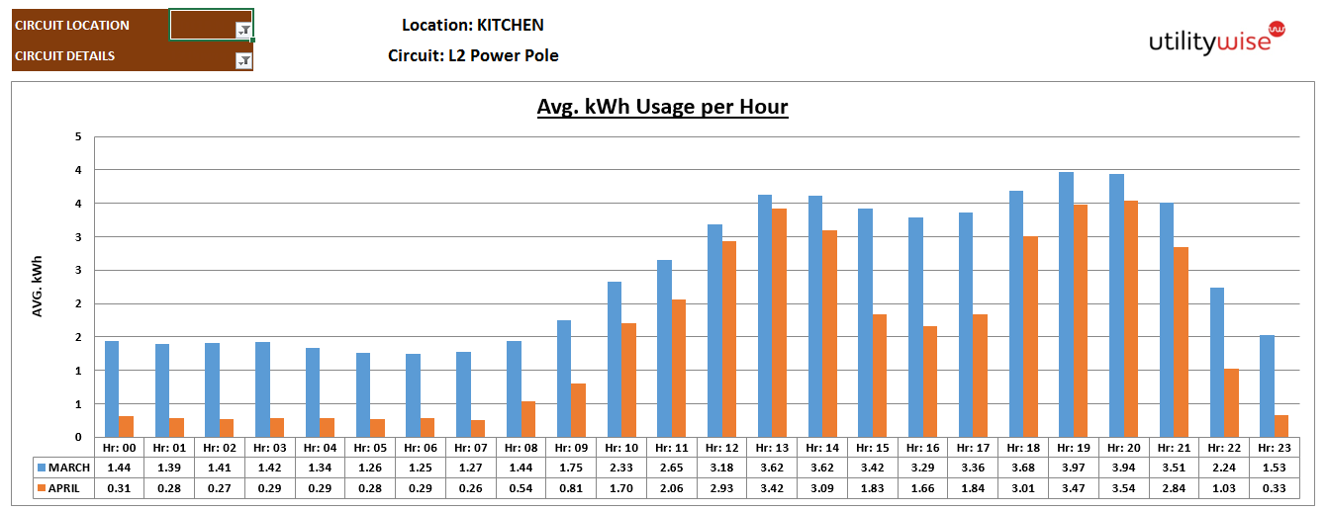
Pass through (plate heater)
Another example BUT MASSIVE saving
Was left on all day and only switched off at night
Off afternoons weekdays only

Slide 14
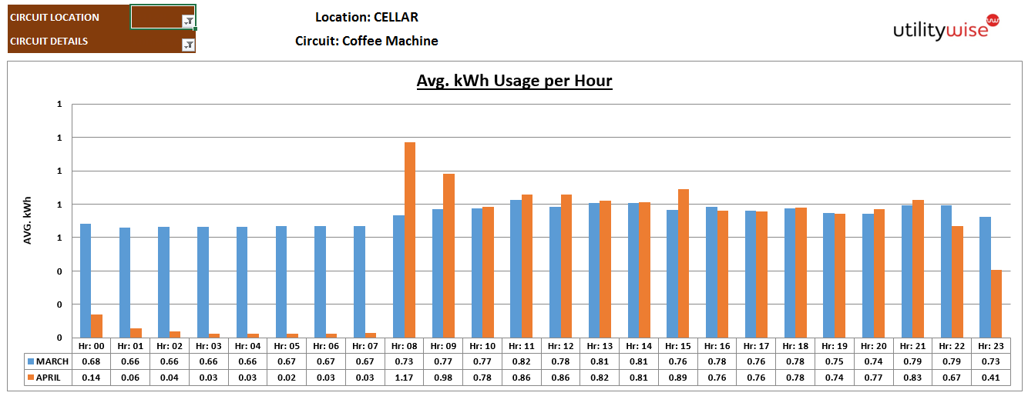
Coffee Machine !!
Even better example

Slide 15
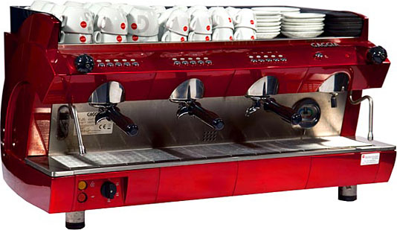
Is this thing insulated at all?

Slide 16
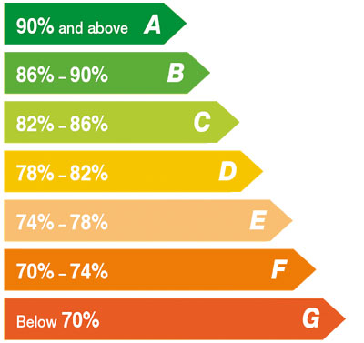
The Gov Should Look at!
Insulation of equipment
Fridges, freezers (done with the A-G)
Why not
  Coffee machines
  Ovens
  Pass
  Plate warmers etc.

Slide 17
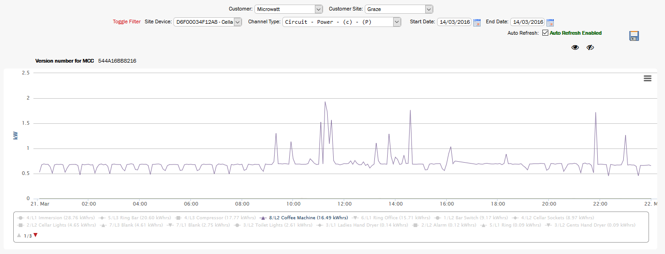
Coffee Machine
Before they started switching it off at night

Slide 18
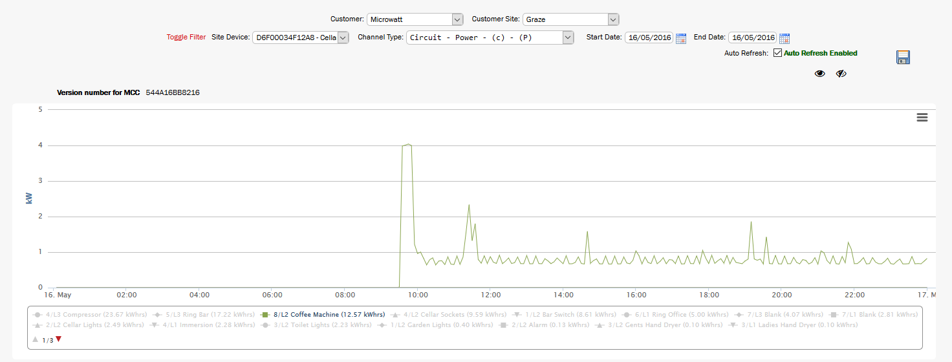
Coffee Machine
After they started switching it off at night
4kWhr saved per day

Slide 19
See how often it cycles
See how often it cycles – Insulation must be crap

Slide 20
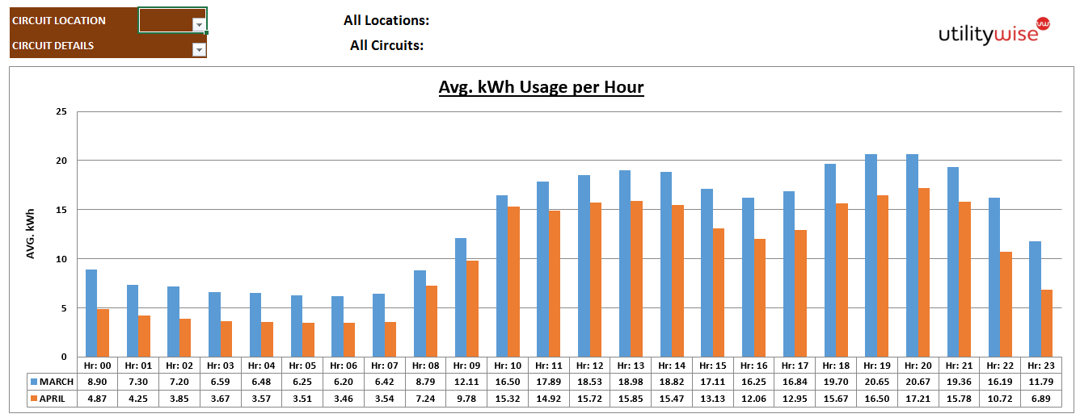
Overall comparing March & April
Shows the 26.5% saving achieved in Mar-Apr

Slide 21
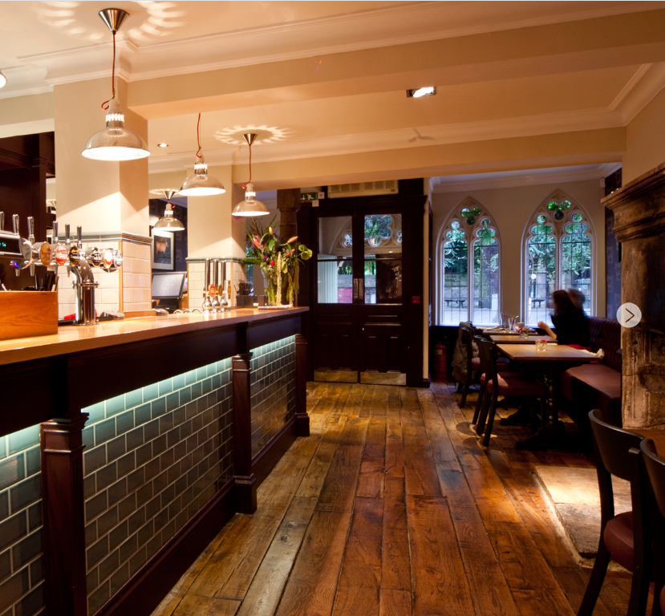
Data presentation
They are Going for 50% Saving
Putting in low energy equipment
Example
  These lights are STILL tungsten
  They are using 7x 116W = 812W
  They are ON
    From 7am to 12pm
    17 hours / day
    THAT’S
    13,804kWh per day
    £2/day

Slide 22
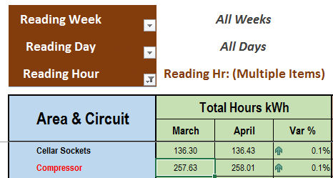
Using the ‘Knowledge’ of consumption
Graze management will select low energy equipment THAT WORKS & evaluate results
Cellar cooling
At night (6pm-6am) you would expect the cooling in the cellar to very low consumption.
Its not 9.2kWh / night !!!!!!

Slide 23
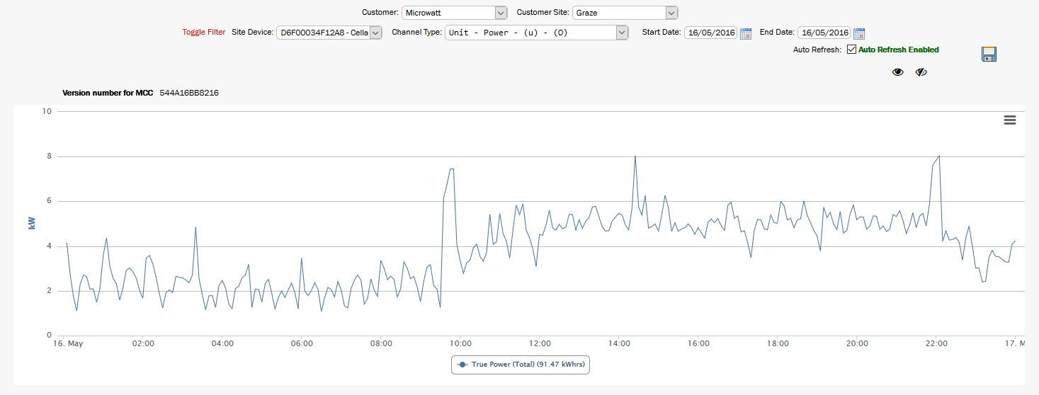
Cellar overall power
Why is the cellar chiller using electricity at night in May? – the outside temp is 10’C average !!!!!!
Even after they put in the curtain.
91.47kWhrs / day in cellar

Slide 24
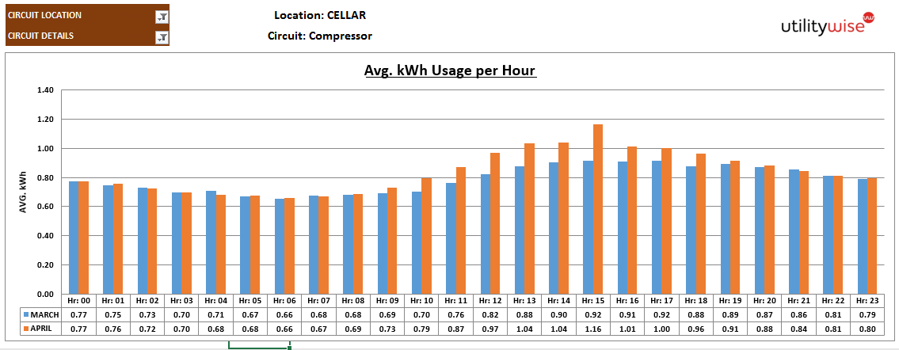
At Night the outside air temp is LOW
Typically below 8°C, therefore you would expect the cooling to be FREE !!
As you can see it is far from FREE

Slide 25
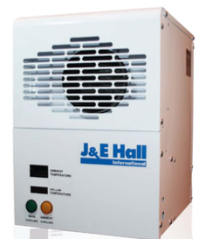
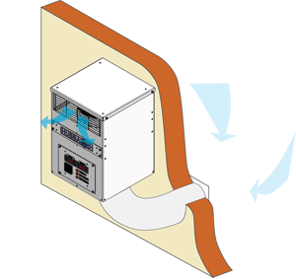
Almost free cooling
Draws cool air in from outside & shuts the compressor off
J&E Say the typical installed cost is £980*
We anticipate Graze could recoup the money within 2½ years.
Based upon days/nights when temp is below 8°C
  Dec ,Jan & Feb all day saving (<8°C)
  Mar, Apr, May, Oct, Nov Nigh Only (<8°C)
  Projected Saving – 2,915kWh = £408/year
This will also prolong the life of your cellar cooling system as it will operate much less time.

Slide 26
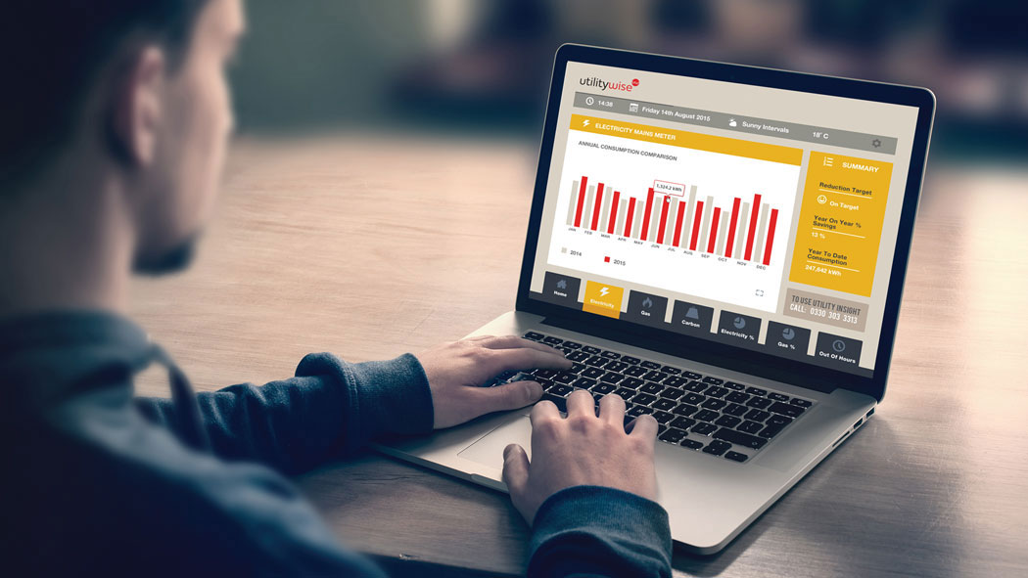
Data presentation & Analysis
This is what it’s all about
  Easy access to the web
  Gives the user all the information they need
  ‘Smart’ analysis of data & recomendations
  Professional analysis of the data available

Slide 27
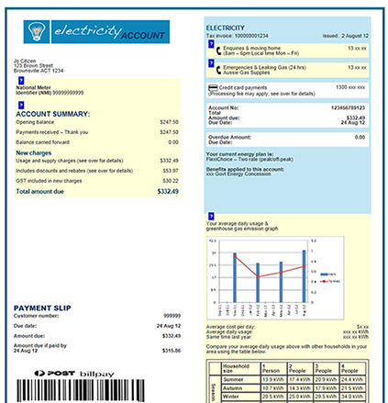
Not This Rubbish from smart meters
How much can these tiny graphs tell anybody?

Slide 28
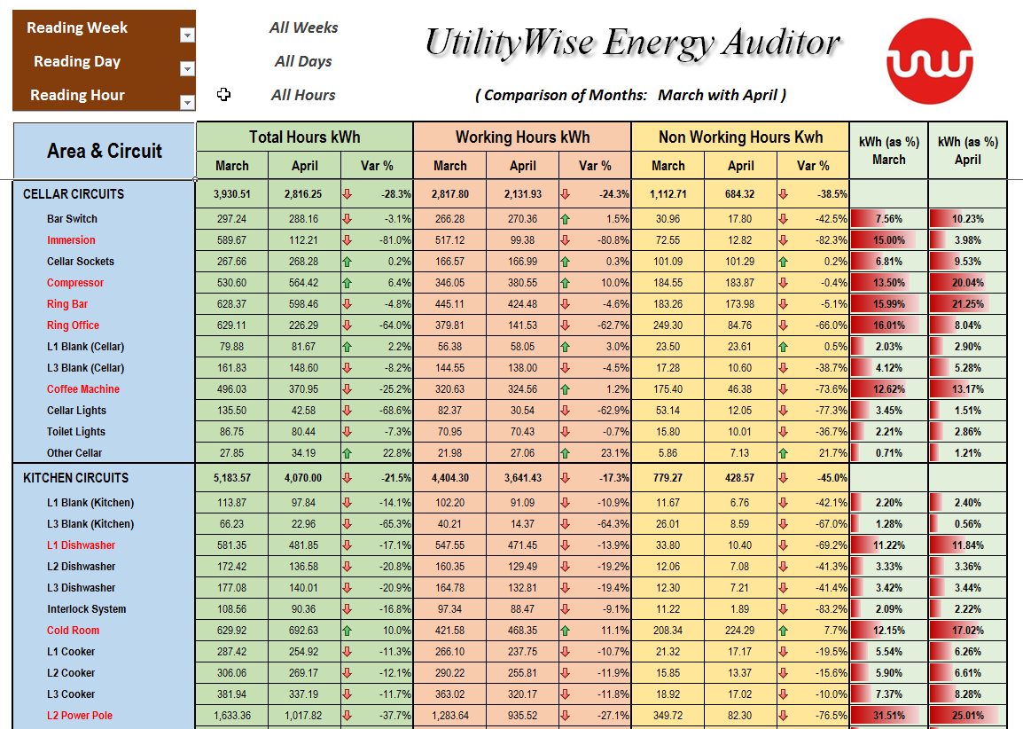
This is a LOT more useful

Slide 29


Slide 30


Opportunity to analyse the data
Can be done; by ‘learning’ apps
Can be done; by ‘learning’ centralised software
Can be done; lead by ‘learning’ human ‘analysts’

Slide 31

Better Still - An App
Free app for every user
Displaying the usage live
Historical data
Analysis
Follow on Facebook

Slide 32
Also Logged
Gas
Water
Micro generators e.g. Solar & Wind
Electricity
  Power Factor
  Voltage, frequency, Current, real/apparent power
  Solar, wind, hydro

Slide 33
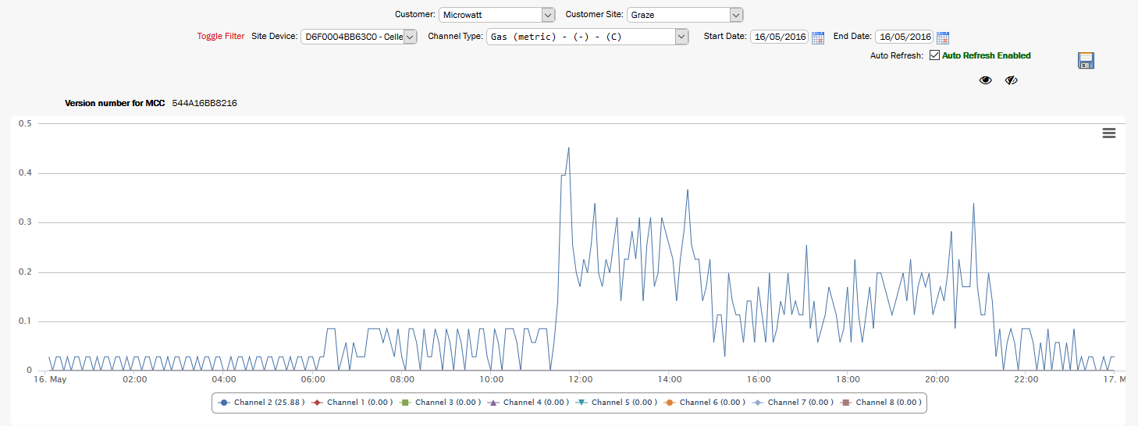
Gas - May
What starts at 6am and cycles? It MUST be inefficient if it’s cycling like that
What’s using gas at night in May?

Slide 34
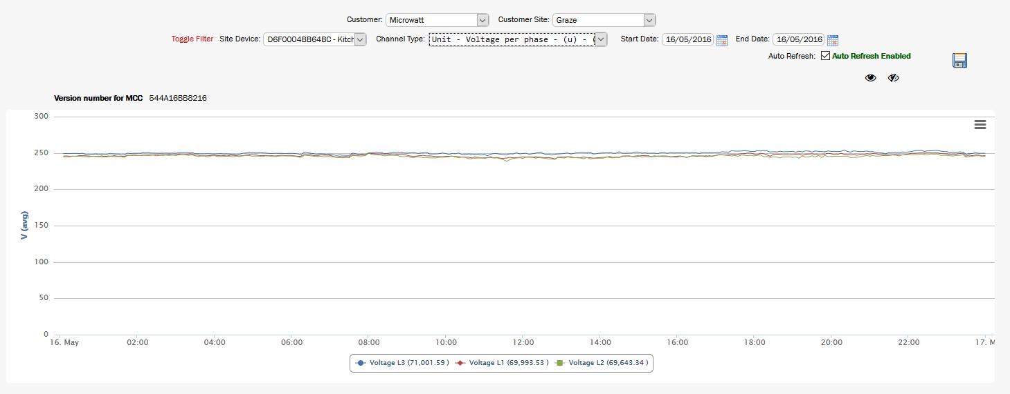
Voltage
Voltage good so OK for induction
Also low losses in feed cable

Slide 35
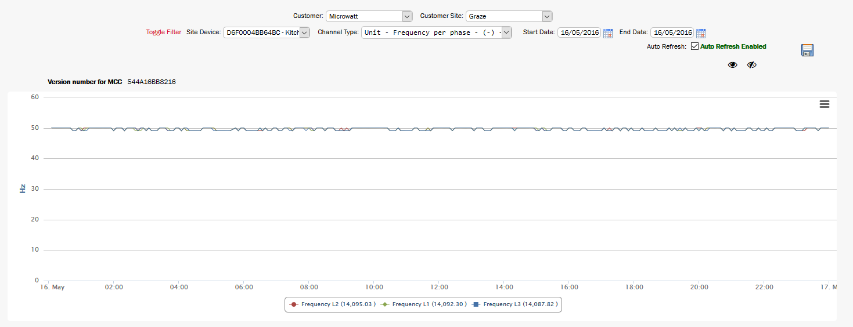
Frequency

Slide 36

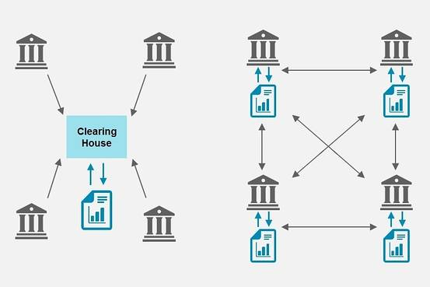
Blockchain
Created for BitCoin
VERY secure
Distributed ledger
POW = Proof of Work
  A proof of work is a piece of data which is difficult (costly, time-consuming) to produce but easy for others to verify and which satisfies certain requirements.
The each&every Meter could buy the electricity in small blocks as and when needed
End of the Big Six !!

Slide 37


Q & A Any Questions?
For more info
contact
‘Professor Spark’
Tel
  +44 (0)1285 643582
  Simon Clegg

